Slide 1
Management Notes

Slide 2
Fear of missing out
Mobile Checking
‘We need to focus to thrive Reclaim focus at home and work”
Chronic Lack of intentionality
System
No Phones past 9. pm
No phones first thing in morning
Daily exercise and meditation
Three tasks to complete each day at work
A moment of gratitude

Slide 3
Strategic management thinking
Core purpose
Funding vs mentor
Teaching(skills) vs mentoring (goals)
Effective Decision making
Emphasize importance of task at hand
Focus on your sensory experience seeing multiple perceptive
Opportunity to learn and grow

Slide 4
Flow Zone
Creativity
‘Sense of Self”
Transient hypfrontality
Self-critical section
The paths to flow
More we concentrate on task, more like we enter it
Mindfulness
‘repetitive basic task’
Focus on breath
Create pathways to flow – find a way not the way
Adjust demansds to fit personal skills
Raise their skills -> higher level of demand
Enhance concentration abilities
Wandering attention –> performance decline
Demands Vs skill
Patters of actions that 🡺 trust
Strenths => misunderstook weakness
Circumstances to identify
Message of character

Slide 5
Focus
Leader has followers
Sorround with good man they trusted
help others to overcome weakness thru delegation
Delegate responsibility
Focus your attention 🡺 here and now
Focus on your sensory expeience
Hard part : not getting started and finding this flow
Find
Projects are subjective and creative pursuites
Puzzles to be solved
To create Proud works
Approach projects with a feeling of ease and trust
Trainings to accomplish your goals

Slide 6
Stress performance
Focus – hidden ingredient in excelleds
Breath
Wandering braing
Disengage – train of thought
Bring focus to breath
Frazzle 🡪 bad stress
Flow 🡪 optimal performance
“Rapt unbreakable concentration” “outdid themselves”
“personal best”
Notes:
Hipo campus

Slide 7
“single result-oriented goal”
Achievement motivation
Authority/Power
Affiliate Motivation
‘set and reset’ challenging but achievable goals
Workaholism
Addiction ot caffine and other simulants
High employee turnover, higher medical stress related accidents absenteeism
Shortened attention spans
Sleep problems

Slide 8
Constant focus on the future
Detaching from work
Positively reflecting about your job after work hours
Cool and controlled breathing
“Stay Interviews”
Pre exist assesments include promse of action
Early warning metrics
About me
Dialogue
Hire tens
Empty org.charts and lace means there
Leader attract leaders
“passing poor performers”
‘Key business leaders and lacing them in roles”
Leadership in agile project
WHAT and How to change
Identifying skills gap – better leader 🡪 reality chech
Try and do it along
Change little by little
Get mentally tough
Learn about behavioural change
‘get to heart of problem and fix it’
Growth trajectory
One company – five years
Best deliverable results
Change may be daunting
Performance Vs people alignment
No new challenges / test your skills

Slide 9
Skillset
Personal summary
Unique sales proposition
Skill summary – same adjectives in adv
Relevant exp – No gaps? Volunteer and wor exp placements
Achievements
Edu and training -> certification
Interests relate with job
References
Body language
Ethos
Walloped

Slide 10
Minimalist desktop
Disorganized manner
Extra distraction 🡪 unimportant tasks
‘attention residue’
‘slugging computing’
‘everything’ folder
“Do not disturb app”
Visual distraction
Categories of tabs
Things to do now
Articles to do later
Sites needing in future
Communication tools
others

Slide 11
Innovation
Next opportunity to make a difference
Culture of innovation
Education
Inspiration
Collaboration
Why are you here
Self-discipline
Testing patience commitment
Tackle all consuming tasks 🡪 big jobs
Balanced structure
Life outside work – maintaining perspective
Doing things that aren’t directly related to work 🡺 Key
“outside world” 🡺 extension of work
“life outside work”
‘team of teams”
“make time for myself”

Slide 12
Pick a system
Prioritization technique
Focus and refocus
Balance
Gamifying mental endurance
Adding Granulatiy
Mental toughness – visualize goal
Sustaining -> passion and conviction
90 second break
Mindfulness – ‘state of active, open attention on the present’
Nutrition and exercise – drink more water live passionately

Slide 13
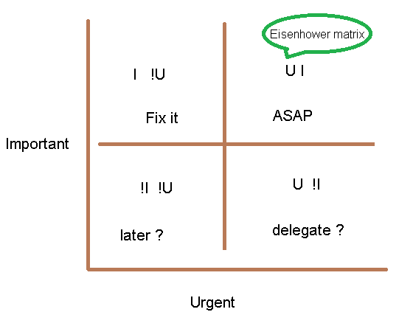
Common habits myth
What habits work for them
Maintain those habits
Self knowledge
Habit finger print
coding habits
Growth mindset
Fixed mindset 🡪 Focus on Focus
Room to grow
Tech aptitude
Leadership skills
Maturity
Wisdom
Master skills of pros 🡪 apply initiatives
“work enviroment”
“thick of things”
“open door policy”

Slide 14
beware the bareness of a busy life
Physiological conditions can impact your energy level positively or negatively. If you were already tired when you tried to do something taxing, you had to fight an uphill battle. Chances are it took you twice as long and you made some missteps.

Slide 15
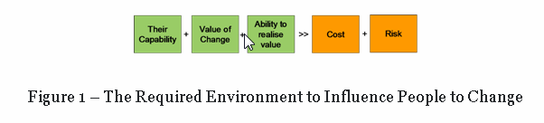

Slide 16
Managing our biases
cyclic pattern of my life and start a spiral pattern inwards out
come out of the dogmatic and frail vision that has been surrounding me since years
I want to inspire myself, time and again

Slide 17
employees who are engaged the most with your business
productive, creative, loyal, and motivated

Slide 18
Leading a self organized team
Recognize what employees need
Assess competence and commitment
Skills and motivation vary our time
Adapt their own style to meet those needs
Leadership style < == > Requirements of organization
Development level
Situational leadership == > Adaptability = > Unsight telling leaders, selling participating delegating

Slide 19
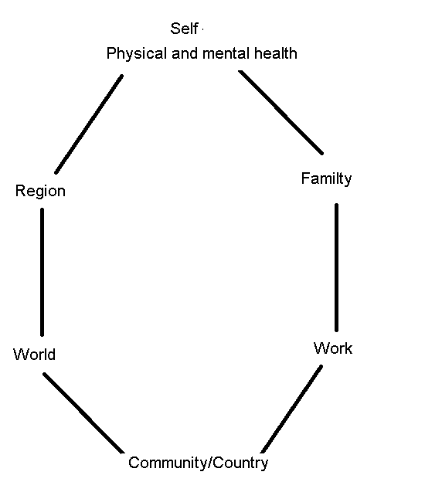
Work Life Balance
Work Vs Life
Koshi – death from overwork

Slide 20
“Self Improvement” 🡪 act of improving us
Disappointment is just a perceptions give attention to solution not the problem
“positive shift” in our thinking
Need schedule
Positive language – master feelings and emotions
Mental and emotional side of things
Focus on goals calm our mind and relax our body
Thoughts actions words
Be kind and considerate negative statements to others
Creating problem solving
Attach with Goals
Smile in adversity
Relex in stress
Listen first
Cant cannot don’t do not wont will not never not
Be creative
Learn more skills
Proper use of time
Notes:
impediment

Slide 21
Listen learn apply do and practice
Be a morning person
Do visualization
Avoid negativity
Follow constructive criticism
Enjoy personal development
Avoid procastination
Be responsible for life
Self delusional
Clear instructions for mind

Slide 22
“Company does not need all expertise”
Avoid bellcurve
Rewards – intrinsic motivation
Proactive performance views
Continous feed back
MBO – goals
Graphic rating scale
Navigating the unknown
Narrow our focus
Discover the unknown
Intelligence era vs Industrial era
imagination age
Habits 🡪 successful
What worked will keep working ?
Comparatable disagreeing
Constructive disagreement kindness/gentleness
Abiline paradox
Team orientation
Collobarative trust
Collective goals
Encourage team players
Constructive vs contentious interactive tactics
Competent team memebers
Honest / open communication norms
Zero-asum assumptions
Negative motion
Package deals – package issues
Ongoing year around rapport
Notes:
nebulous

